Slide 1
Budget sales analytics
Domain-Retail & Sales

Slide 2
Problem Summary
Our "Domain Sale" process is structured to help potential buyers purchase the domain they want immediately without the hassle of contacting the seller directly. ... A seller lists a domain for sale at a specific price in our Marketplace. An interested buyer sees this domain for sale and decides to buy it.
Extract various information such as Sales, budget, and variance. You can even compare sales and budgets with various attributes. Extract necessary information about Products and Customers. Make the necessary dashboard with the best you can extract from the data.

Slide 3
General KPi
Yearly Income with Sales Amount
Sales Amount per Region
Gender/Marital Status wise Sales
Category-wise Expensive Items

Slide 4
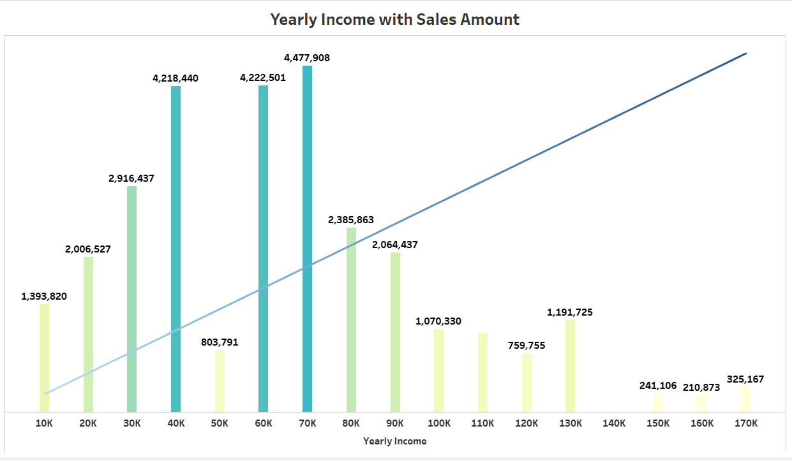
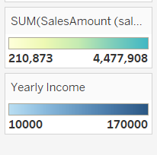
Yearly Income with Sales Amount

Slide 5
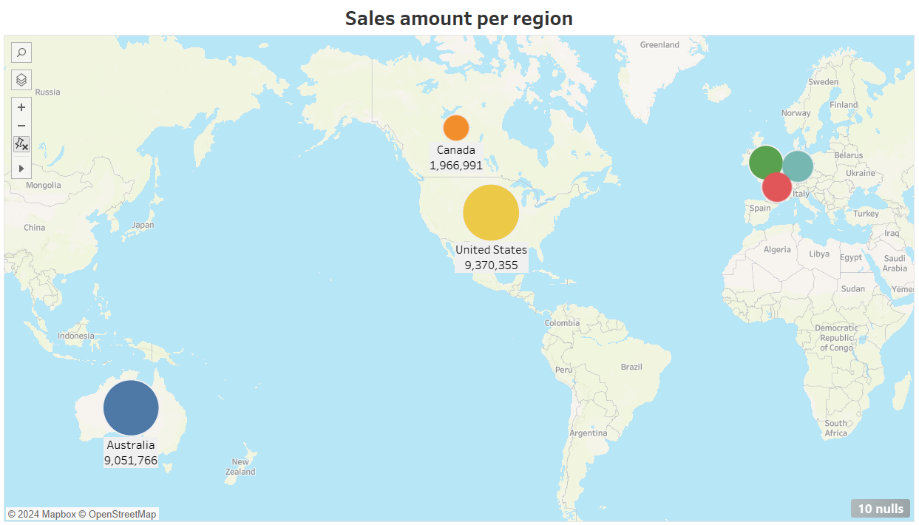
Sales amount per region

Slide 6
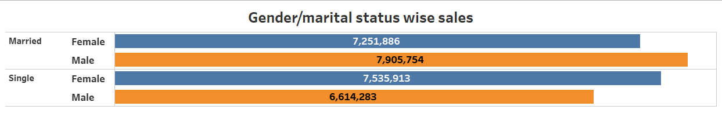
Gender/Marital Status wise Sales

Slide 7
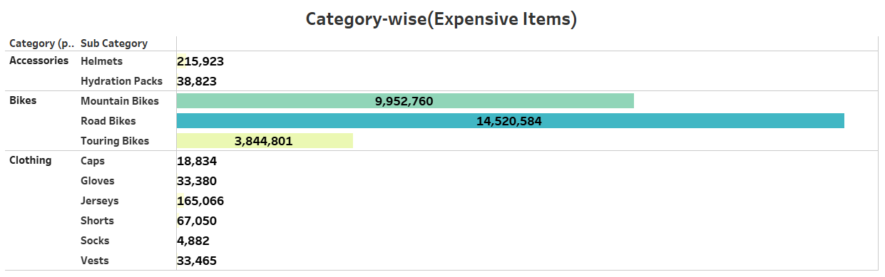
Category wise expensive items

